Slide 1
– CWZ Standard –
Diagrams
Manny Insignares
March 21 2024

Slide 2
CWZ Reference Architecture

Slide 3
Connected Work Zone Physical Architecture
Work Zone Data Exchange
Traffic Management Center
WorkZoneFeed
External
Consumer Center
Work Zone Center
DeviceFeed
Traffic Management Center
Work Zone Center
DeviceFeed
External
Consumer Center
Work Zone Data Exchange with Intermediary
Traffic Management Center
WorkZoneFeed
WZ Data Exchange Intermediary
WorkZoneFeed
External Consumer
Center
Work Zone Center
DeviceFeed
WZ Data Exchange Intermediary
DeviceFeed
Traffic Management
Center
Work Zone Center
DeviceFeed
WZ Data Exchange Intermediary
DeviceFeed
External Consumer
Center

Slide 4
Connected Work Zone Physical Architecture
(Compatibility with the Connected Vehicle Environment)
Compatibility with the Connected Vehicle Environment
Traffic Management Center
NTCIP 1218
Roadside
Unit
(RSU)
J2945/4 RSM
Generic Vehicle
(OBU)
This diagram will be included in an Annex that will contain guidance for connected work zones that will deploy elements of the connected vehicle environment.

Slide 5
ARC-IT Service Package Diagram
Data Structure

Slide 6
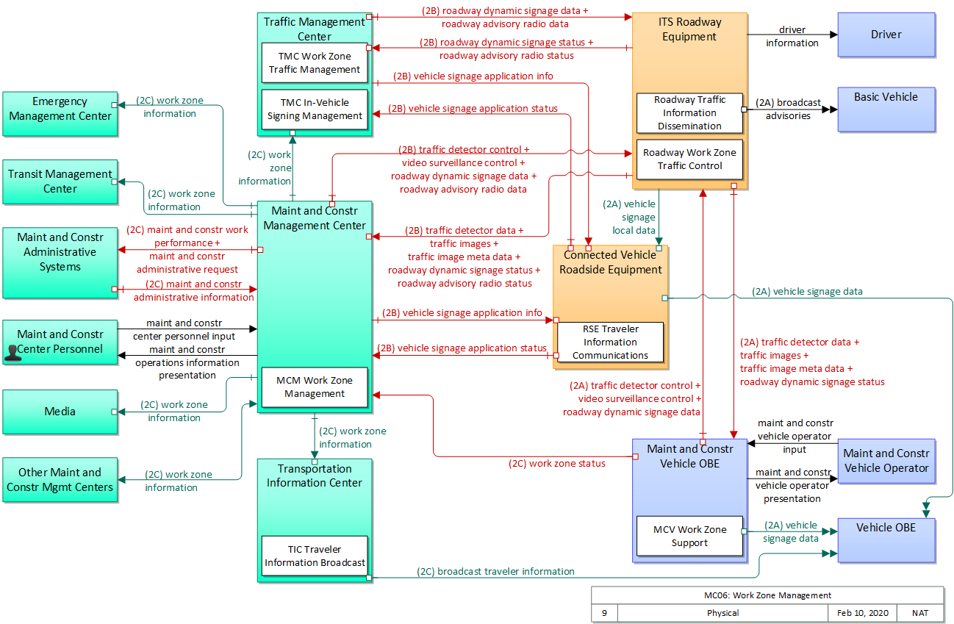
MC06: Work Zone Management

Slide 7
CWZ Standard ConOps
Data Structure

Slide 8
CWZ ConOps – Work Zone Information Organization
Zone Information
Zone Metadata
Zone Location
Zone Schedule
Zone Status
Zone Lanes
Zone Speed Limit
Zone Traffic Data
Zone Device
Zone VRU Device
Zone Work Vehicle Device

Slide 9
WZDX Work Zone Feed
Data Structure

Slide 10
WZDX 4.1 – Work Zone Feed Data Structure
road event feed info
feed info
Feature Collection
Work Zone Feed
feature
data source
event type
related road events
road names
direction
name
description
creation date
update date
relationship
properties
core details
location description
verification status
dates
vehicle travel impact
location method
worked presence status
speed limits
restriction geometry descriptions
types of work
lanes status and description
LineString
geometry
MultiPoint
bbox
bbox

Slide 11
WZDX Work Zone Device Feed
Data Structure

Slide 12
WZDX 4.1 – Device Feed Data Structure (1/3)
feed info
Feature Collection
feature
Work Zone Device Feed
properties
(varies with device)
id
core details (FieldDevice)
device type
data source
device status
update date
has automatic location
road direction
road names
name (of device)
description
status messages
is moving
road event ids
milepost
make
model
serial number
firmware version
(device specific properties)
geometry
bbox
bbox

Slide 13
WZDX 4.1 – Device Feed Data Structure (2/3: Arrow Board, Camera, Dynamic Message Sign, Flashing Beacon)
feed info
Feature Collection
Work Zone Device Feed
feature
properties
(varies with device)
id
core details (FieldDevice)
Arrow Board
pattern
is_in_transport_position
Arrow Board
Arrow Board
Camera
image_url
image_timestamp
Camera
Camera
Dynamic Message Sign
Dynamic Message Sign
message_multi-string
Flashing Beacon
function
is_flashing
sign_text
geometry
bbox
bbox

Slide 14
WZDX 4.1 – Device Feed Data Structure (3/3: Hybrid Sign, Location Marker, Traffic Sensor)
feed info
Feature Collection
Work Zone Device Feed
feature
properties
(varies with device)
id
core details (FieldDevice)
dynamic_message_function
dynamic_message_text
static_sign_text
Hybrid Sign
marked_locations type *
Hybrid Sign
afad
delineator
flagger
lane-shift
lane-closure
personal-device
temporary-traffic-signal
ramp-closure
road-closure
road-event-start
road-event-end
work-zone-start
work-zone-end
Location Marker
marked_locations * (array)
road_event_id
Location Marker
Traffic Sensor
collection_interval_start_date
collection_interval_end_date
average_speed_kph
volume_vph
occupancy_percent
lane_data
Traffic Sensor Lane Data
lane_order
road_event_id
average_speed_kph
volume_vph
occupancy_percent
geometry
bbox
bbox

Slide 15
J2945/4
Data Structure

Slide 16
J2945/4 Road Safety Message Data Structure (1/4: Common Container -> Event Info)
Road Safety Message
commonContainer
eventInfo
eventID
eventUpdateCount “revision number”
eventCancellation
startDateTime
endDateTime
endDateTime
eventReccurence
causeCode & subCauseCode
affectedVehicles
regionInfo
contentContainer
reduced speed zone container
lane closure container
situational container
incident container

Slide 17
J2945/4 Road Safety Message Data Structure (2/4: Content Container -> Region Info)
Road Safety Message
commonContainer
eventInfo
regionInfo
applicableHeading
referencePoint
locationUncertainty
endDateTime
referencePointType
descriptiveName
approachRegion
contentContainer
reduced speed zone container
lane closure container
situational container
incident container

Slide 18
J2945/4 Road Safety Message Data Structure (3/4: Content Container -> Reduced Speed Zone Container & Lane Closure Container)
Road Safety Message
common Container
content Container
reduced Speed Zone Container
regulatory speed limit
Region Info
(see 2/4)
lane Closure Container
(one of)
lane status
lane position
lane closed
lane close offset
lane status varies
Region Info
(see 2/4)
situational container
incident container

Slide 19
J2945/4 Road Safety Message Data Structure (4/4: Content Container -> Situational Container & Content Container -> Incident Container)
Road Safety Message
common container
content container
reduced speed zone container
lane closure container
situational container
(one of)
obstructions
location
description
people present
anomalous traffic
applicable region
(see Region Info 2/4)
incident container
responder type
incident location
(see Region Info 2/4)

